Slide 1

AI Programming & Self-Driving Car
Notes:
OBS:Desktop

Slide 2
Acknowledgement
Cytron
RaspberryPi.org
Notes:
OBS:Desktop
Before we begin, I am grateful to these resources which shapes the delivery and content of this workshop.

Slide 3
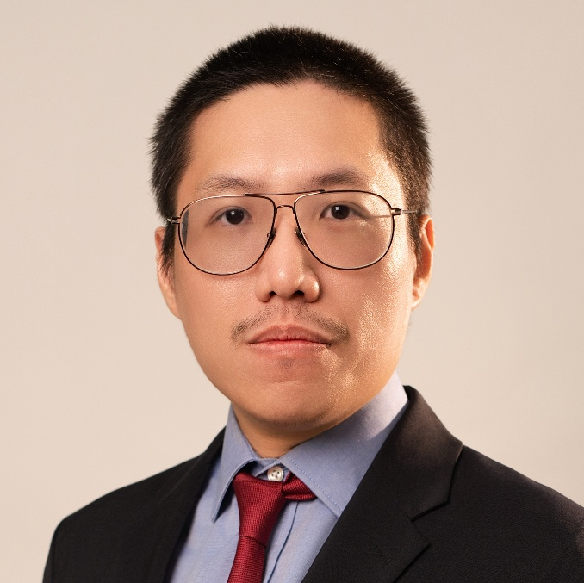
Hello. I’m Daniel Vong.
Ts. Daniel Vong
BEng (Hons), BSc, CEng, MIET, MCP
Co-Founder & CTO, Wangi Lai PLT
Notes:
OBS:Desktop
With that, allow me to introduce myself.
My name is Daniel Vong.
I am the Co-Founder and CTO at Wangi Lai PLT that designs and developed the BAWA Cane, a clip-on smart device for existing white canes for the blind and visually impaired to better navigate their surrounding environment.
I started my startup journey after having gone through the heart-breaking ordeal of my late grandmother losing her sight due to cataract and glaucoma.
I graduated with a Bachelor of Engineering (Hons) (Robotics & Mechatronics) and Bachelor of Computer Science.
In addition, I am a 3 times Microsoft Certified Professional specializing in Internet of Things, Power Platform, and AI.
I am a Professional Technologist registered with Malaysia Board of Technologist (MBOT).
I am a Chartered Engineer recognised by Engineering Council UK and a member of Institution of Engineering and Technology working towards my European Engineer status with Engineers Europe.
Last, but most importantly, I am a HRD Corp Accredited Trainer.

Slide 4
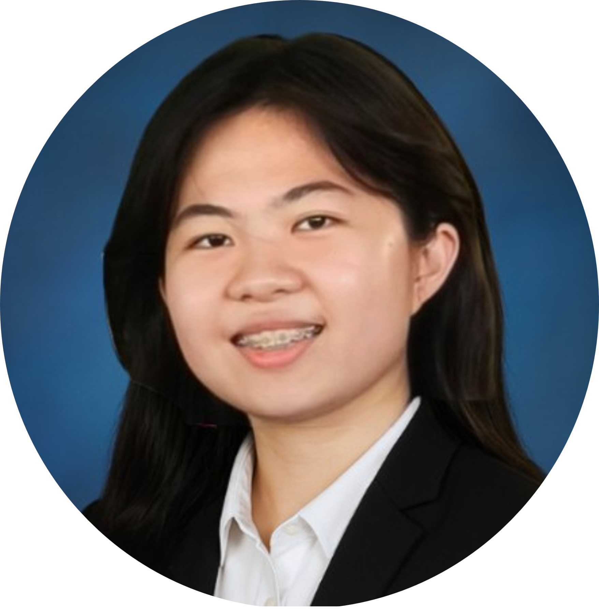
Hello. I’m Tong En.
Lim Tong En
AI Engineering Intern, Wangi Lai PLT
EEE Student in University of Southampton Malaysia
Notes:
OBS:Desktop
With that, allow me to introduce myself.
My name is Daniel Vong.
I am the Co-Founder and CTO at Wangi Lai PLT that designs and developed the BAWA Cane, a clip-on smart device for existing white canes for the blind and visually impaired to better navigate their surrounding environment.
I started my startup journey after having gone through the heart-breaking ordeal of my late grandmother losing her sight due to cataract and glaucoma.
I graduated with a Bachelor of Engineering (Hons) (Robotics & Mechatronics) and Bachelor of Computer Science.
In addition, I am a 3 times Microsoft Certified Professional specializing in Internet of Things, Power Platform, and AI.
I am a Professional Technologist registered with Malaysia Board of Technologist (MBOT).
I am a Chartered Engineer recognised by Engineering Council UK and a member of Institution of Engineering and Technology working towards my European Engineer status with Engineers Europe.
Last, but most importantly, I am a HRD Corp Accredited Trainer.

Slide 5
AI Programming & Self-Driving Car
Notes:
OBS:Desktop

Slide 6
Unit Outline
Session 1: Introduction to Hardware
Session 2: Introduction to Python
Session 3: Computer Vision & Object Recognition
Session 4: Assembly & Integration of Software and Hardware
Session 5: Challenge & QnA
Notes:
OBS:Round

Slide 7
AI Programming & Self-Driving Car
Session 4
Notes:
OBS:Desktop

Slide 8
Learning objectives
In this session, you will:
Know about to the Ultimate Challenge for AI Programming & Self-Driving Car
Assemble the robo-car
Implement basic robo-car movement
Implement pre-trained model and lane detection
Notes:
OBS:Round

Slide 9
Session 4: Assembly & Integration of Software & Hardware
Day 3
Notes:
OBS:Round

Slide 10
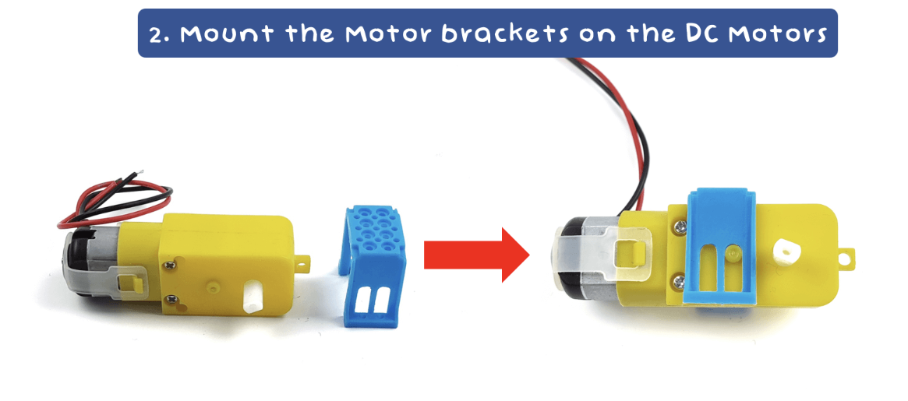
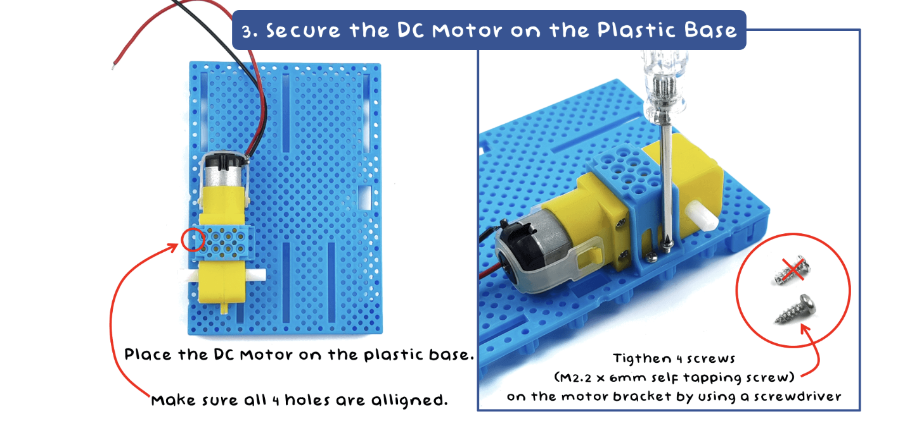
Assembling Robo-car
Step 1:

Slide 11
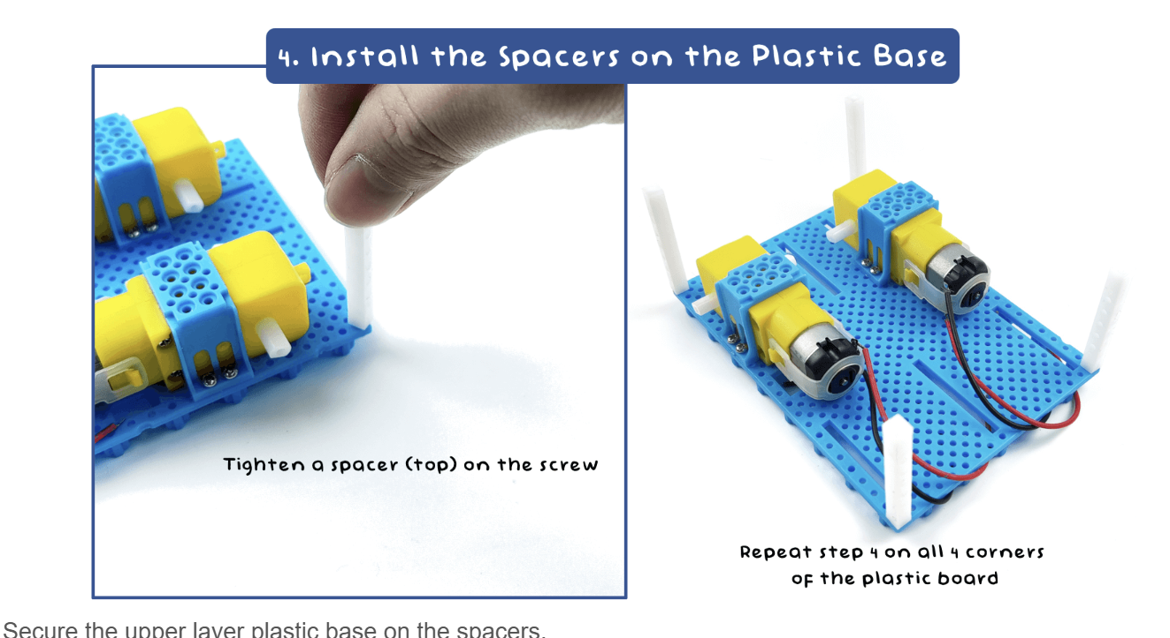
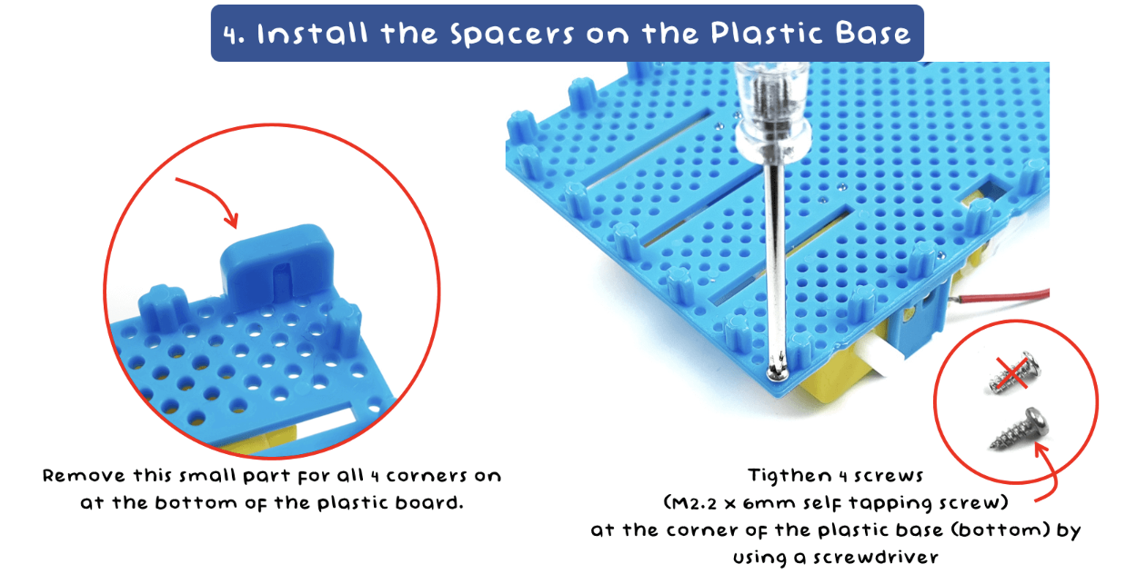
Assembling Robo-car
Step 2:

Slide 12
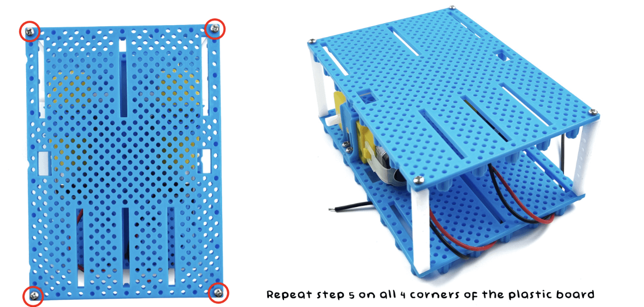
Assembling Robo-car
Step 3:

Slide 13
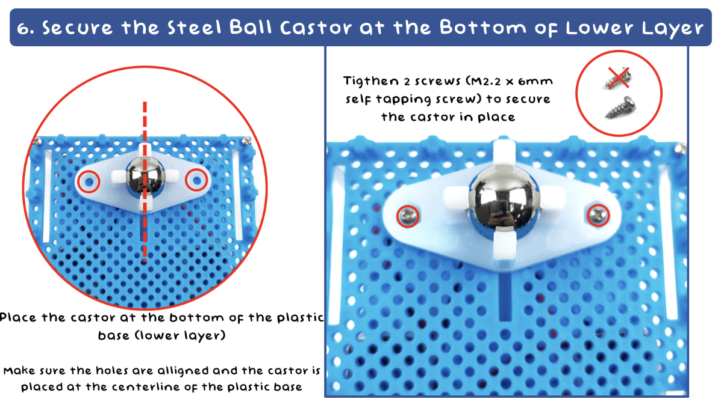
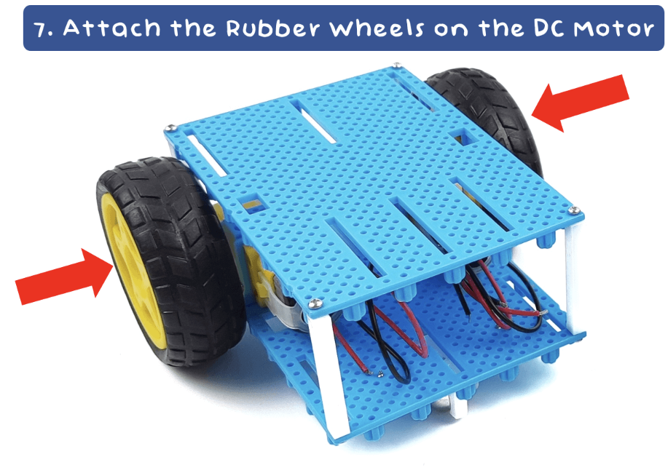
Assembling Robo-car
Step 4:

Slide 14
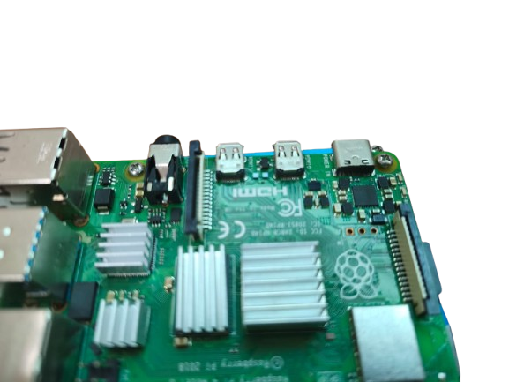
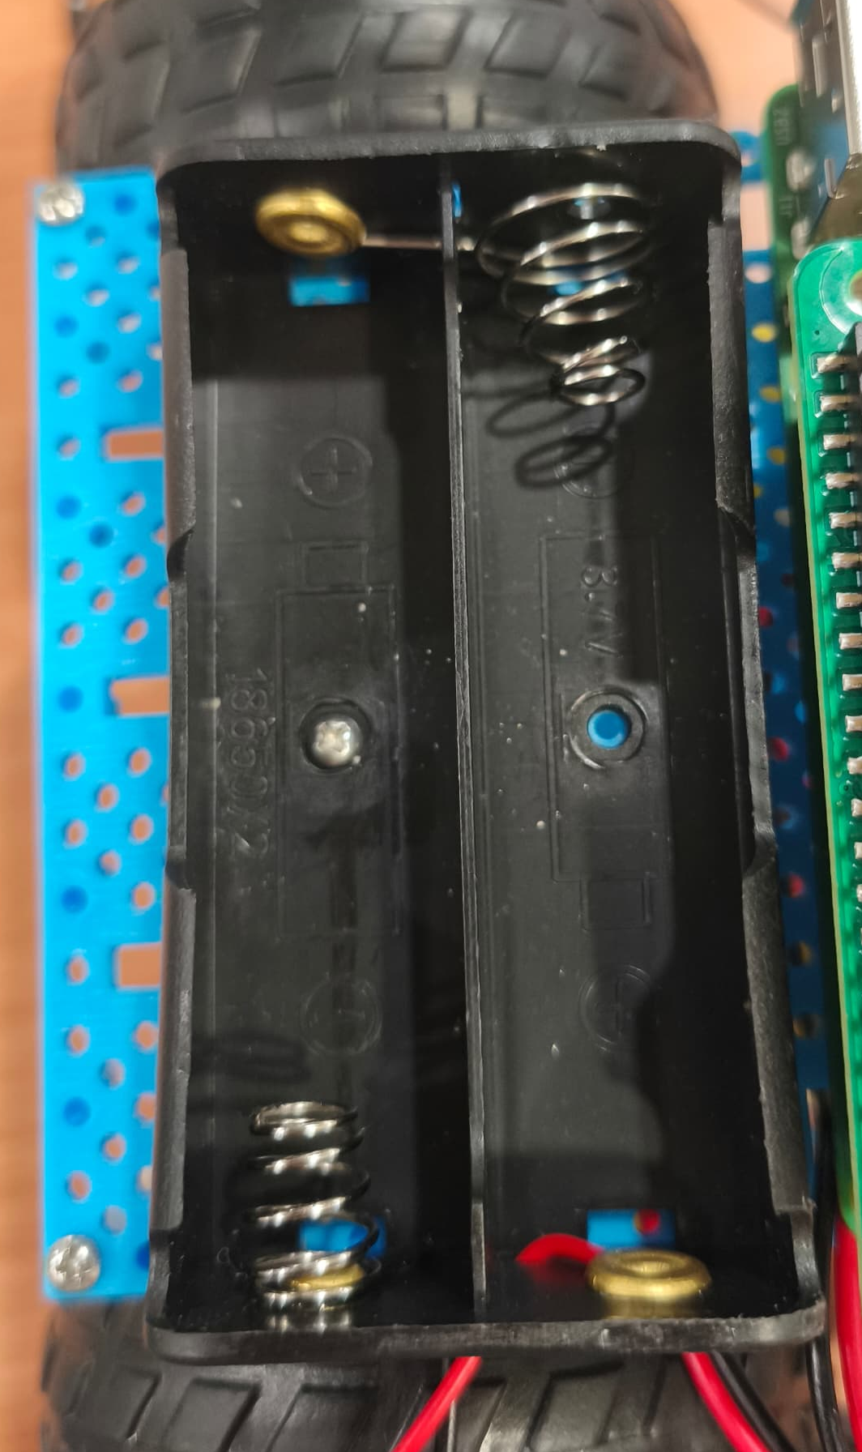
Assembling Robo-car
Step 5:

Slide 15
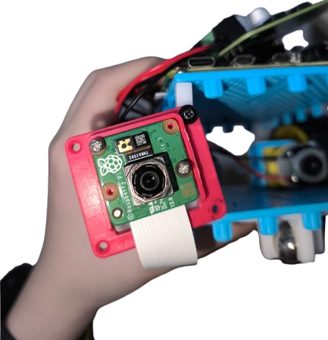
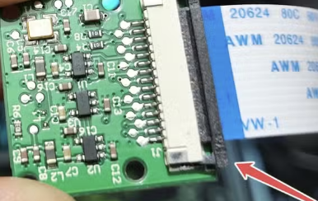
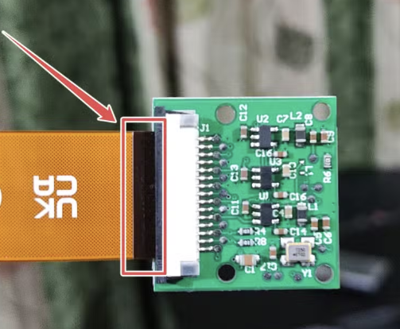
Assembling Robo-car
Step 6:
Gently pulled up the black plastic connector
Slide in ribbon wire
Ensure that black side of ribbon is facing black color connector.
Press the plastic black connector down

Slide 16
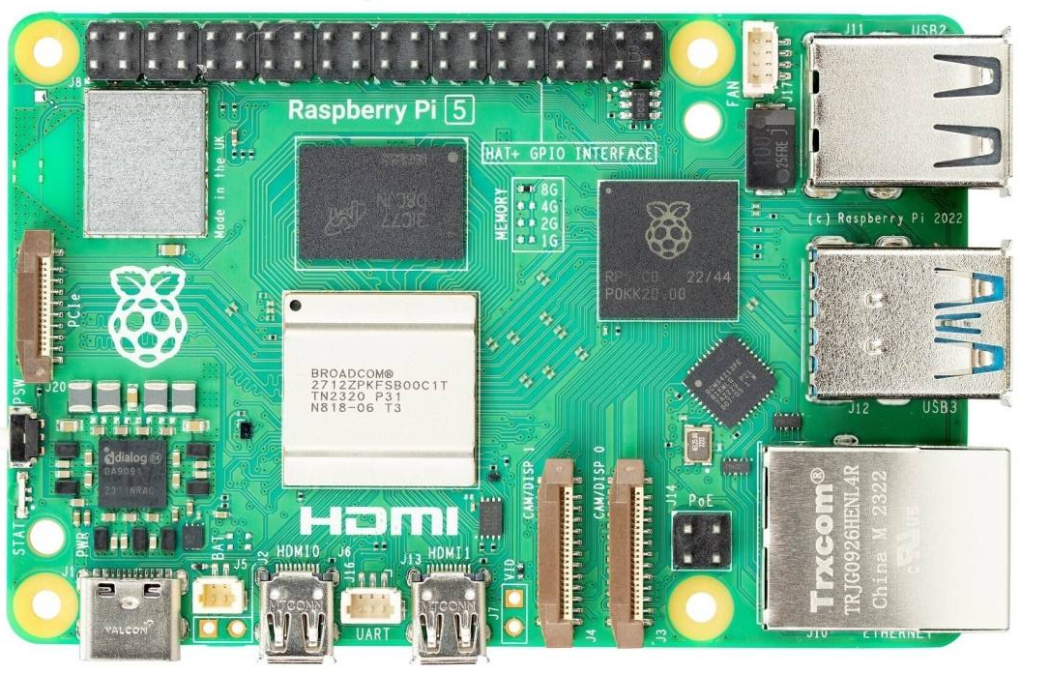
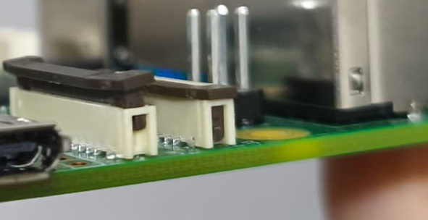
Assembling Robo-car
Step 7:
Note: Ensure that black side of ribbon is facing black color plastic connector.

Slide 17
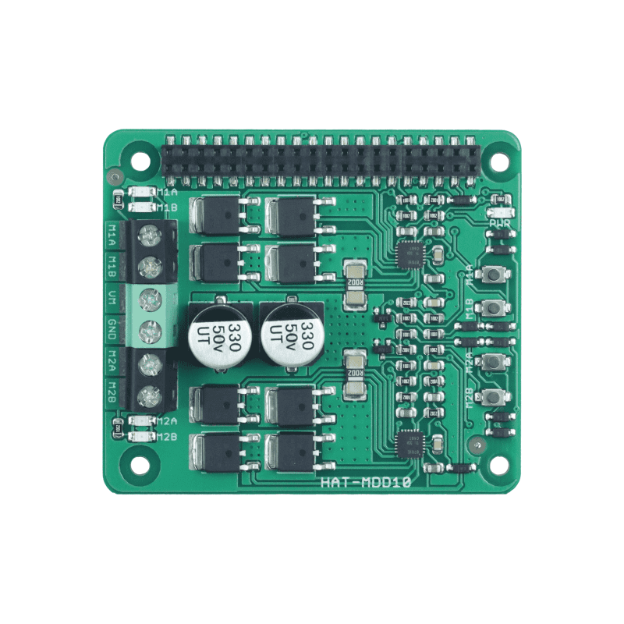
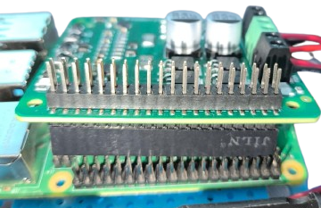
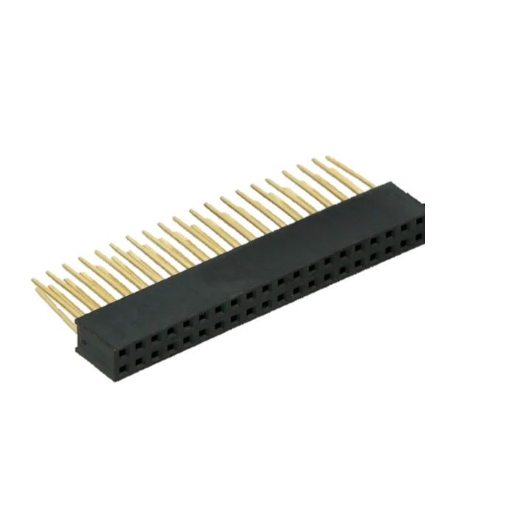
Assembling Robo-car
Step 8:
Note:
Screw up to insert wire
Screw down to lock wire
Snap the driver hat onto Raspberry Pi
Note: Kindly use an extended connector
Black wire
Motor 1
(Left)
Black wire
Motor 2 (Right)
Red wire
Motor 1
(Left)
Red wire
Motor 2
(Right)

Slide 18
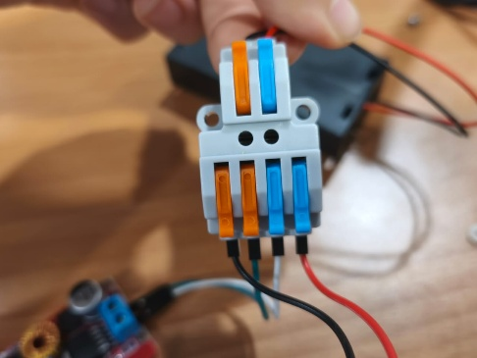
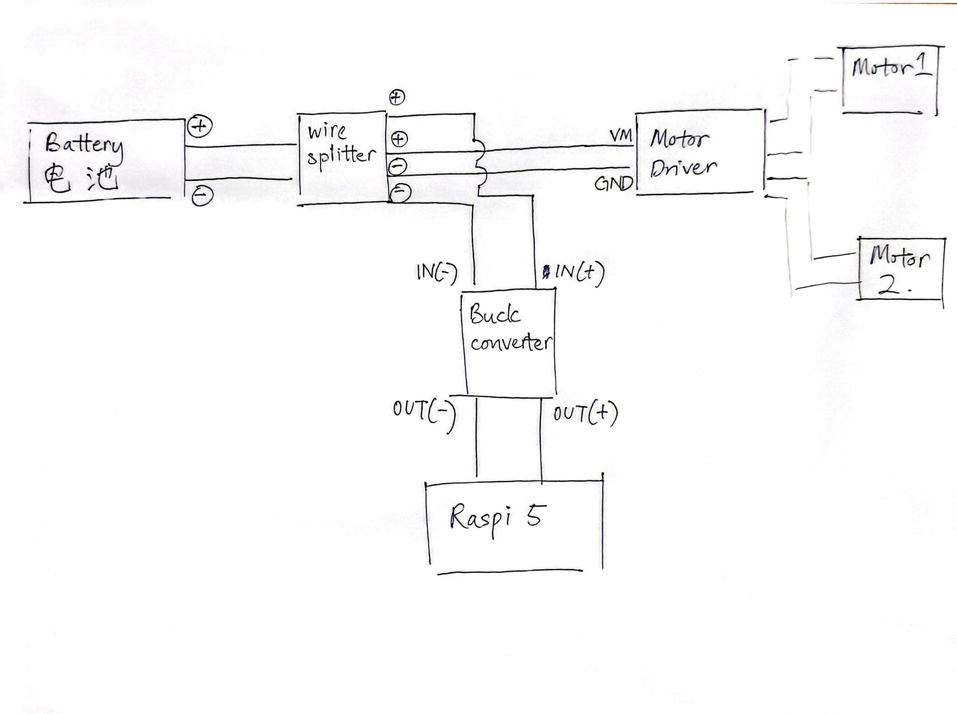
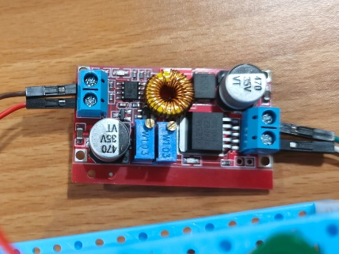
Circuit Connection Schematic

Slide 19

Wire Splitter Connection
Step 9:
Positive 1, 正极 1
Positive 2, 正极 2
Buck
Converter
Motor
Driver
Positive, 正极
Battery
Negative, 负极
Negative 2, 负极 2
Negative 1, 负极 1

Slide 20
Wire Splitter to Motor Driver
Step 10:
Positive 1, 正极 1
Negative 1, 负极 1

Slide 21

Wire Splitter to Buck Converter
Step 11:
IN +
Positive 2, 正极 2
Negative 2, 负极 2
IN -
OUT+
OUT-

Slide 22
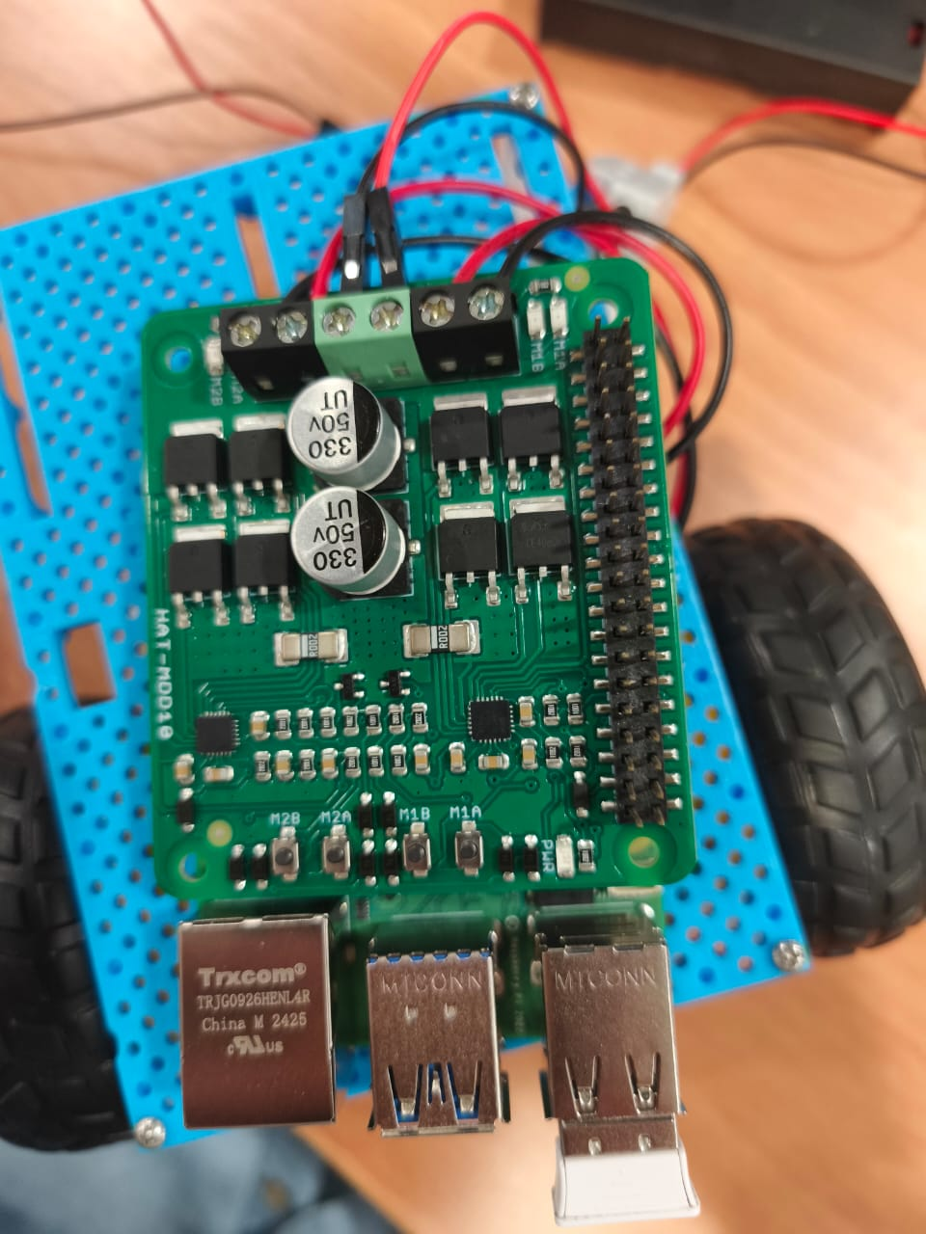
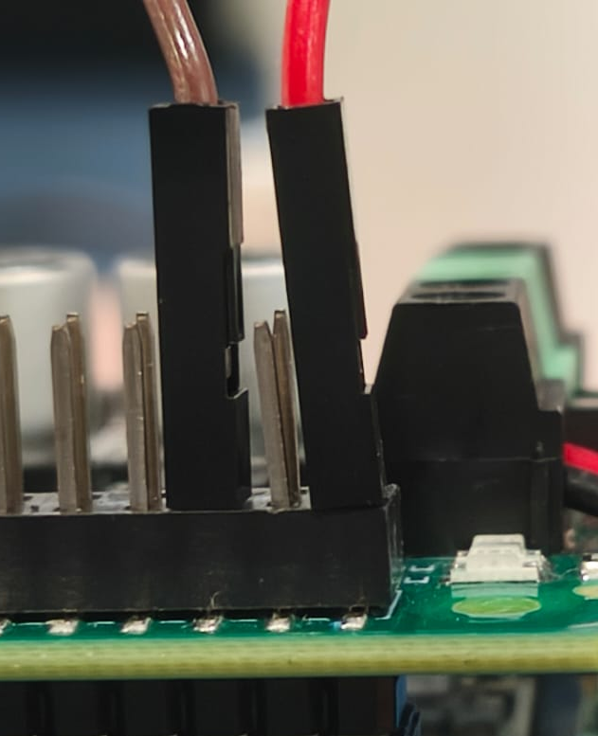
Buck Converter to Raspi 5
Step 12:
OUT-
OUT+
OUT+
OUT-

Slide 23
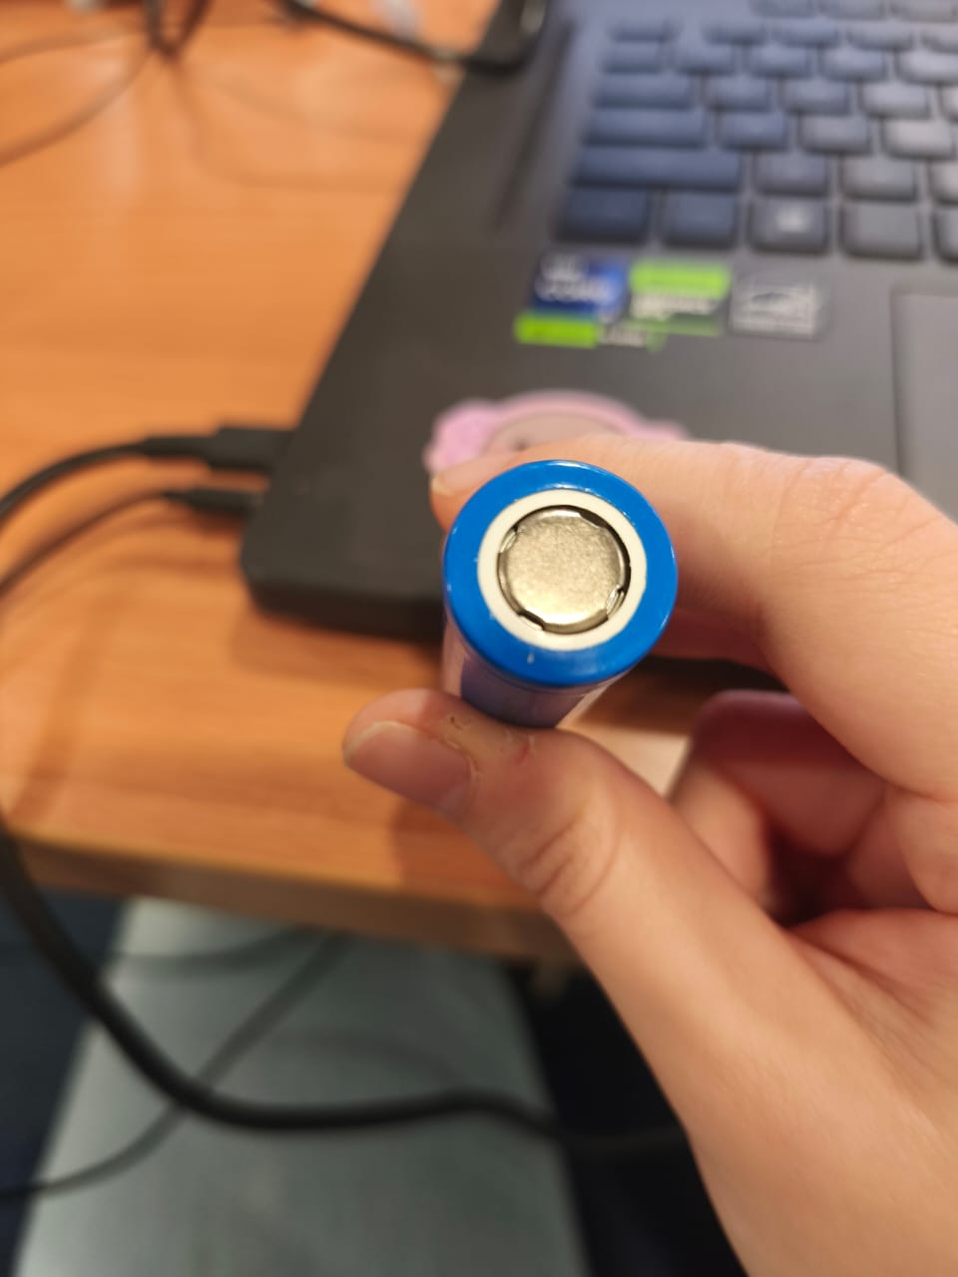
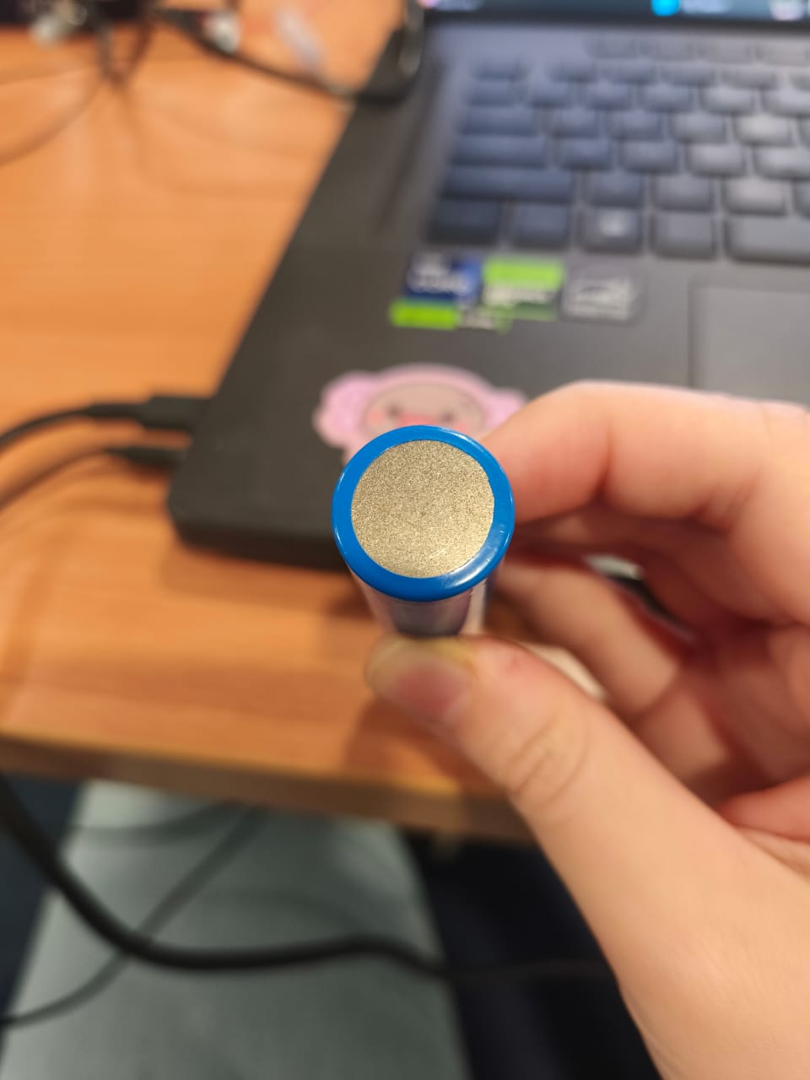
Li-Po Battery Polarity
Positive, 正极
Negative, 负极

Slide 24
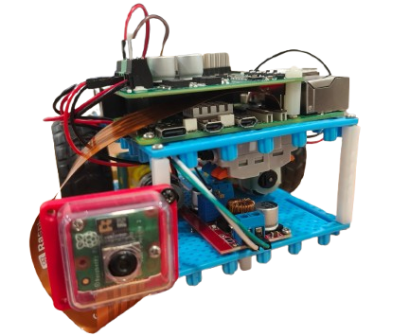
Assembling Robo-car
Your final product:

Slide 25
Basic Motor Movement
# move_forward(speed,duration)
# turn_left(speed,duration)
# turn_right(speed,duration)
# stop_motors(speed,duration)
from motor import Motor
myMotors = Motor()
myMotors.start()
myMotors.move_forward(40,0.3)
myMotors.stop_motors()
motor_controller.stop()

Slide 26
OpenCV RiCam Detection
Import libraries and dependencies.
Initialize Camera object
Load pre-trained Model
Process captured frames with model
Annotate results onto frames
Define direction for motor based on detection
Show final frames

Slide 27
OpenCV RiCam Detection Example
from picame import Camera,getImg
import cv2
from ultralytics import YOLO
picam2 = Camera()
picam2.start_now()
model = YOLO("my_model_cone.pt")
cap = picam2.start_capture()
img = getImg(cap)
img = picam2.resizeImg(img)
results = model(img)
for result in results:
class_name = utils.extract_class_name(result)
if class_name == "cone":
#Do something if cone not detected
else:
#Do something if cone not detected
if cv2.waitKey(1) & 0xFF == ord('q’):
picam2.camStop(img)

Slide 28
Lane Detection Example
from motor import Motor
from LaneModule import getLane
from picame import Camera,getImg
import cv2
picam2 = Camera()
picam2.start_now()
while True:
cap = picam2.start_capture()
img = getImg(cap)
img = picam2.resizeImg(img)
curveVal= getLane(img)
sen = 0.85 # SENSITIVITY
maxVAl= 0.3 # MAX SPEED
if curveVal>maxVAl:
curveVal = maxVAl
if curveVal<-maxVAl:
curveVal =-maxVAl
print(curveVal)
if cv2.waitKey(1) & 0xFF == ord('q’):
picam2.camStop(img)
motor.MotorStop_Lane()
motor.stop()
break

Slide 29
Overall Structure
Import libraries and dependencies: motor, LaneModule, picame, cv2, ultralytics, and utils.
Initialize global objects and variable: Motor, Camera and DirectionList.
Define main() function to handle object detection and lane following.
Main() loop continuously until cv2.waitKey(1) & 0xFF == ord('q’) is met

Slide 30
Knowledge check
What does histogram detection help with in lane detection?
It shows where the lane lines are by counting bright pixels in each column.
It detects traffic signs.
It changes the color of the lane lines.
What is a common challenge when detecting lanes on real roads?
The lanes are always perfectly straight.
Lighting changes, shadows, and occlusions by other vehicles.
Roads have no lanes.
Cameras cannot capture images at night.
Notes:
OBS:Round
1. A:
2. B:

Slide 31
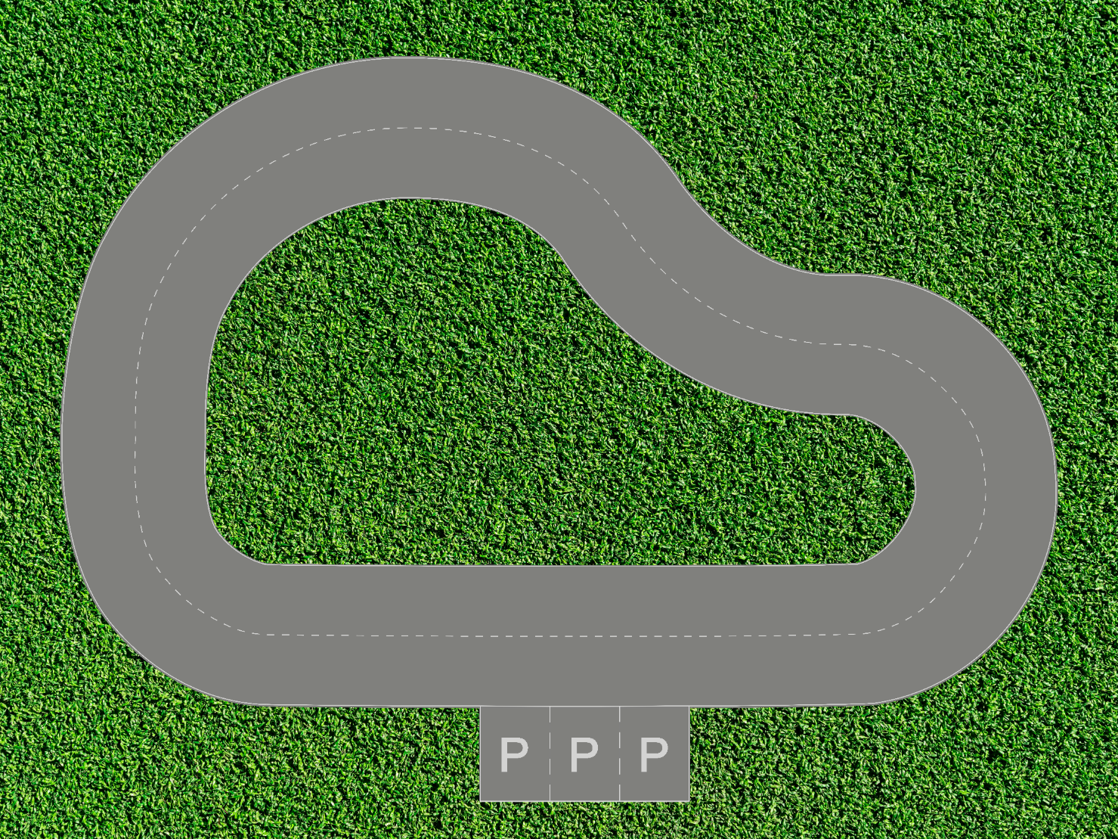
Ultimate Challenge: Self-Driving Car
Task:
Program your car such that it leave from carpark and drive autonomously within the road on playmat.
Optional: Use Object Detection to do something fun with the cone.
请编程使您的小车从停车位出发，并能在游戏垫上的道路上自主行驶。
附加任务：使用物体检测功能与路障锥进行有趣的互动。

Slide 32
Summary
In this session:
We assembled the robo-car
Ready for the ultimate challenge: Self-Driving Car
Notes:
OBS:Round

